Slide 1
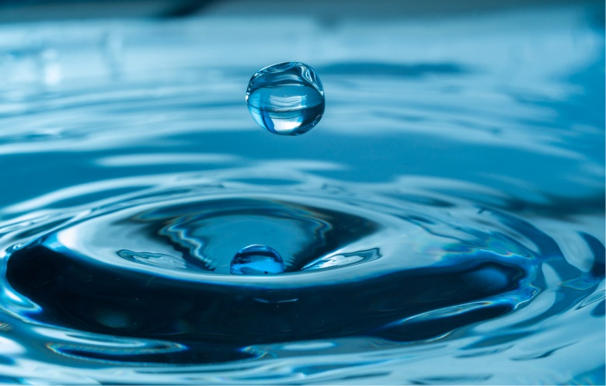

WATER
What is Water?
Water is a compound of two elements: hydrogen and oxygen.
Water has many special properties.
Water is vital to all plant and animal life on Earth.

Slide 2
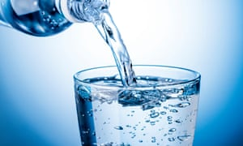
Where can we get water?
About 97% of the water on the Earth’s surface is in the world’s oceans.
This is where you can find most of the other 3%
> Lakes
> Rivers
> Polar ice caps
> Clouds
> Rain
> Sea ice

Slide 3
Water uses in the home
Gallons of water
Series1:Gallons of water uses at home daily(without water conservation)
Series2:Gallons of water uses at home daily(with water conservation)

Slide 4
DROUGHT EARLY WARNING SYDTEM: INDIA
Drought condtions (percentage area)
Time | None | D0-D4 | D1-D4 | D2-D4 | D3-D4 | D4
26/03/2023 | 57.55% | 41.62% | 31.17% | 16.59% | 10.90% | 6.09%
19/03/2023 | 57.41% | 41.75% | 31.35% | 11.06% | 11.06% | 6.14%
24/02/2023 | 57.68% | 41.48% | 31.57% | 11.06% | 11.06% | 5.91%
26/12/2022 | 58.14% | 41.03% | 30.87% | 10.40% | 10.40% | 5.48%
26/03/2022 | 57.93% | 41.23% | 27.76% | 5.30% | 5.30% | 1.65%
D1: Moderate Dry D2:Serve Dry D3:Extreme Dry
D4: Exceptional Dry D0:Abnormally Dry None: No Drought

Slide 5
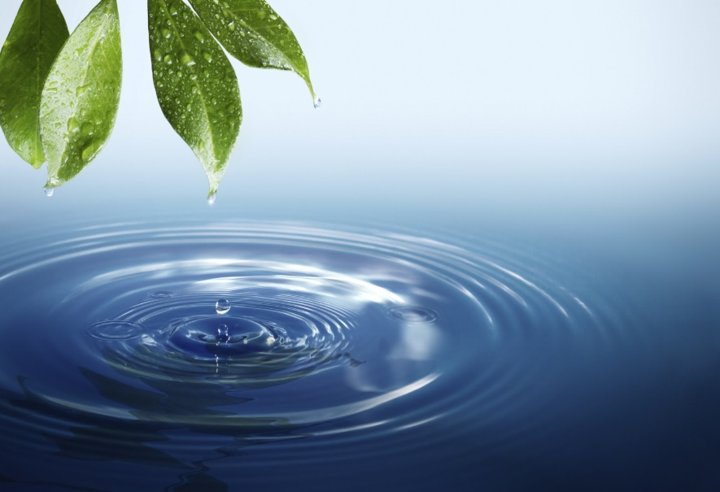
METHODS TO SAVE WATER
1. Check your toilet for leaks
2. Stop using your toilet as an ashtray or wastebasket
3. Put a plastic bottle in your toilet tank
4. Take shorter showers
5. Install water-saving shower heads or flow restrictors
6. Turn off the water while brushing your teeth
7. If you wash dishes by hand, don't leave the water running for rinsing

